Slide 1

DESIGN OF A MOBILE PRECISION IRRIGATION SYSTEM FOR SMALL SCALE COMMERCIAL FARMERS
TANATSWA KASIRORI - H240598Q
ZOE KARIPACHE - H240530B
MCEBO MAHLANGU– H240707W
TIVAKUDZE MAGUNDA- H240464A

Slide 2
PROBLEM BACKGROUND
Agriculture accounts for about 70% of global freshwater withdrawals (FAO)
Many small‑scale farmers still rely on surface or furrow irrigation system
Conventional systems apply water across the entire field, including non‑planted areas
Potatoes have a shallow root system and require carefully controlled soil moisture.

Slide 3
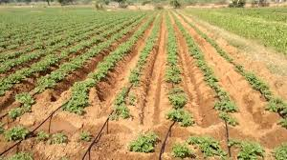
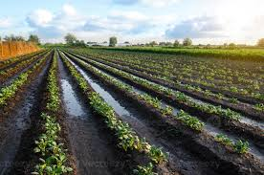
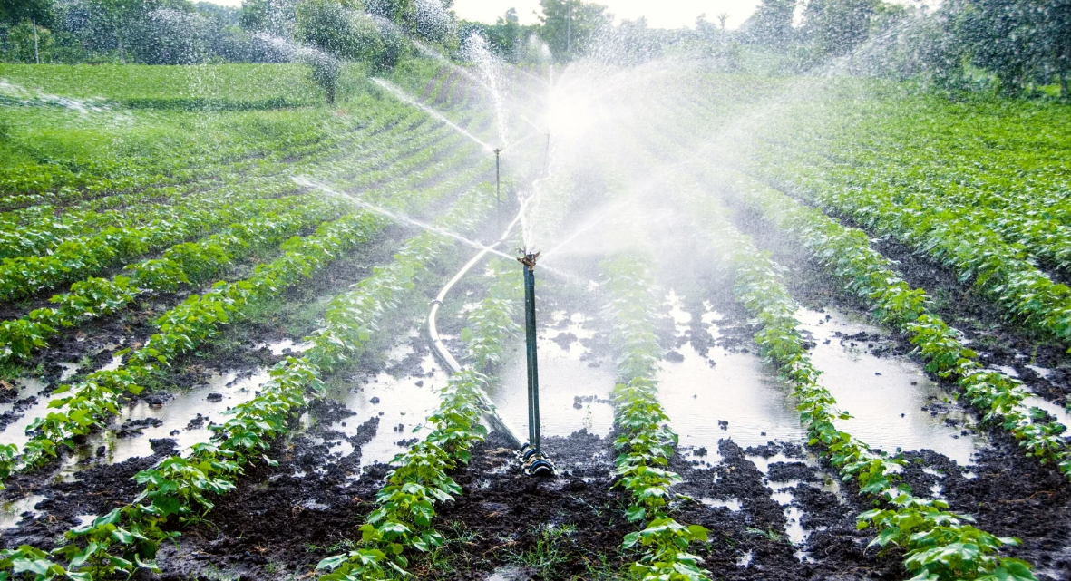

Slide 4
LITERATURE REVIEW
Agriculture uses 70% of global water
Irrigation efficiency is critical in water-limited areas — inefficient methods cause losses via runoff, percolation & evaporation (World Bank, 2021).
Drip irrigation systems
Precision irrigation technologies
Mobile irrigation systems
Sensor-Based Line Detection in Agriculture
Irrigation Timing and Control Systems
Synthesis of Existing Irrigation Systems: Achievements and Research Gaps

Slide 5
PROBLEM STATEMENT
Current irrigation practices among small-scale commercial potato farmers in Natural Region II waste water by irrigating the the entire area without focusing on the plants.

Slide 6
AIM
To design and develop a mobile precision irrigation system capable of delivering controlled water quantities on potato crop level to improve irrigation efficiency on small‑scale commercial farms up to 5 ha.

Slide 7
OBJECTIVES
To design an irrigation structure aligned with 90 cm potato row spacing to enable direct root‑zone water delivery.
To develop a water flow control system that regulates the amount of water supplied per hectare
To design a wheeled frame that moves at a controlled speed along potato field rows.

Slide 8
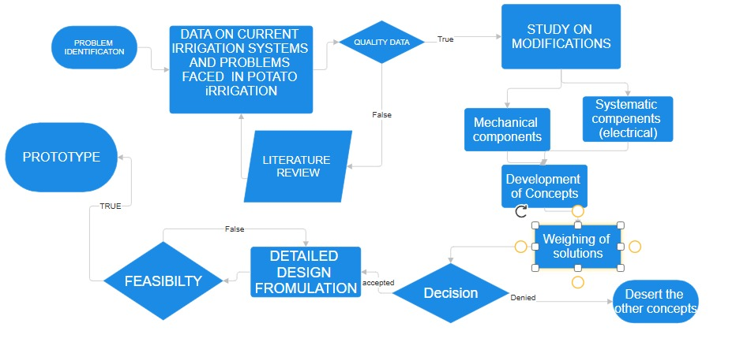
RESEARCH METHODOLOGY

Slide 9
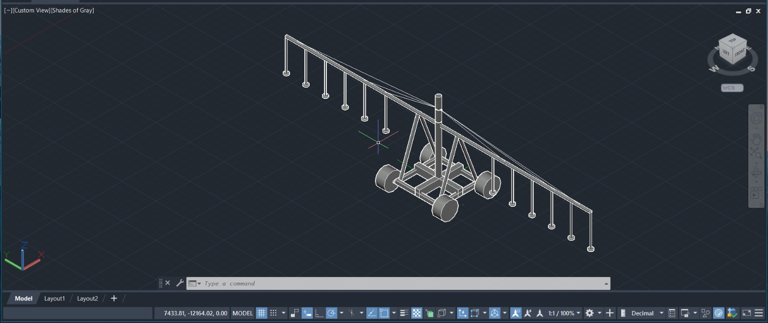
CONCEPT 1

Slide 10
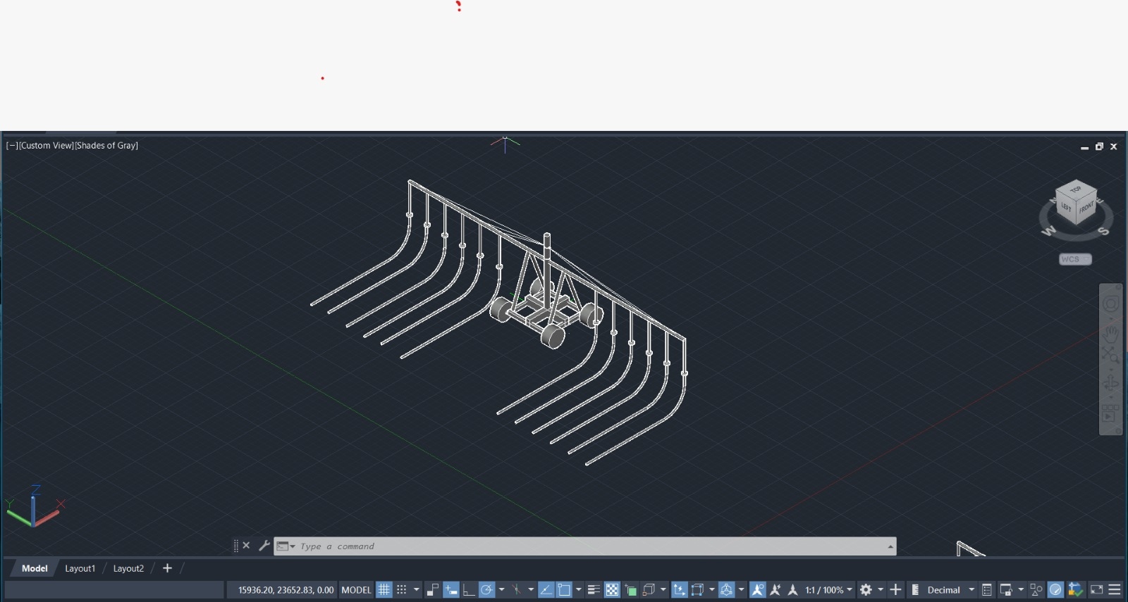
CONCEPT 2

Slide 11
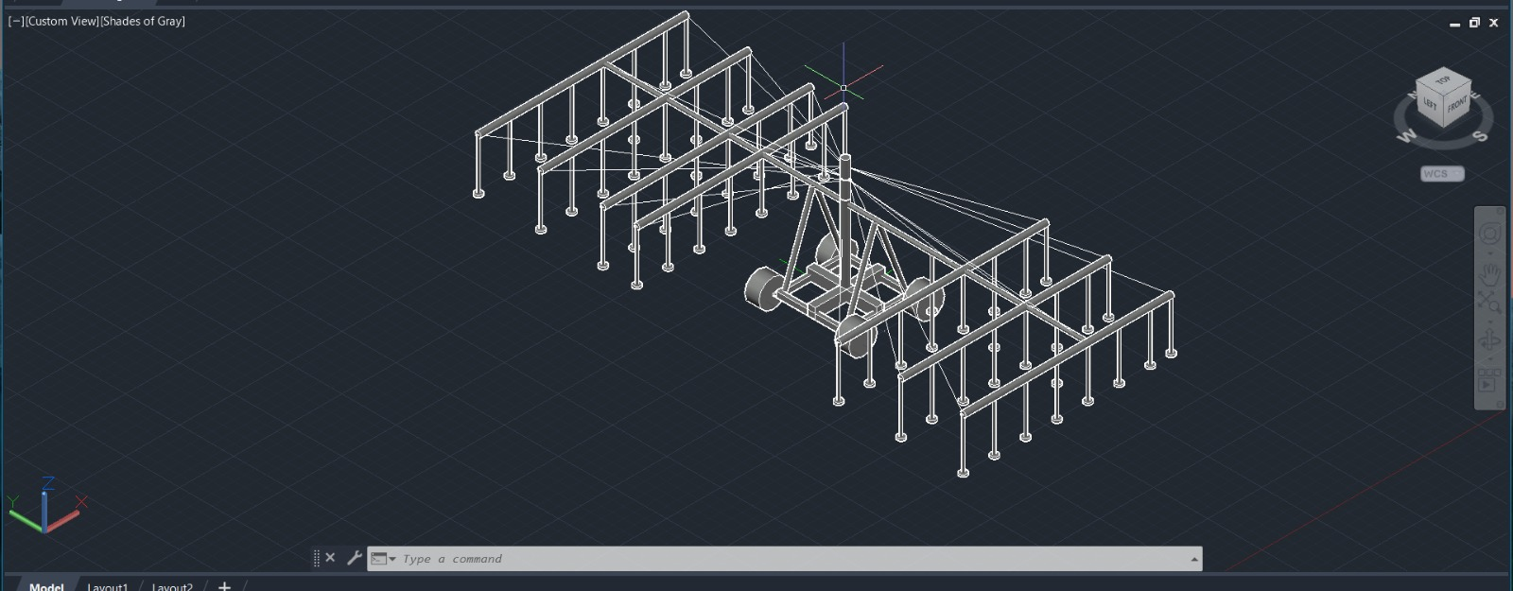
CONCEPT 3

Slide 12
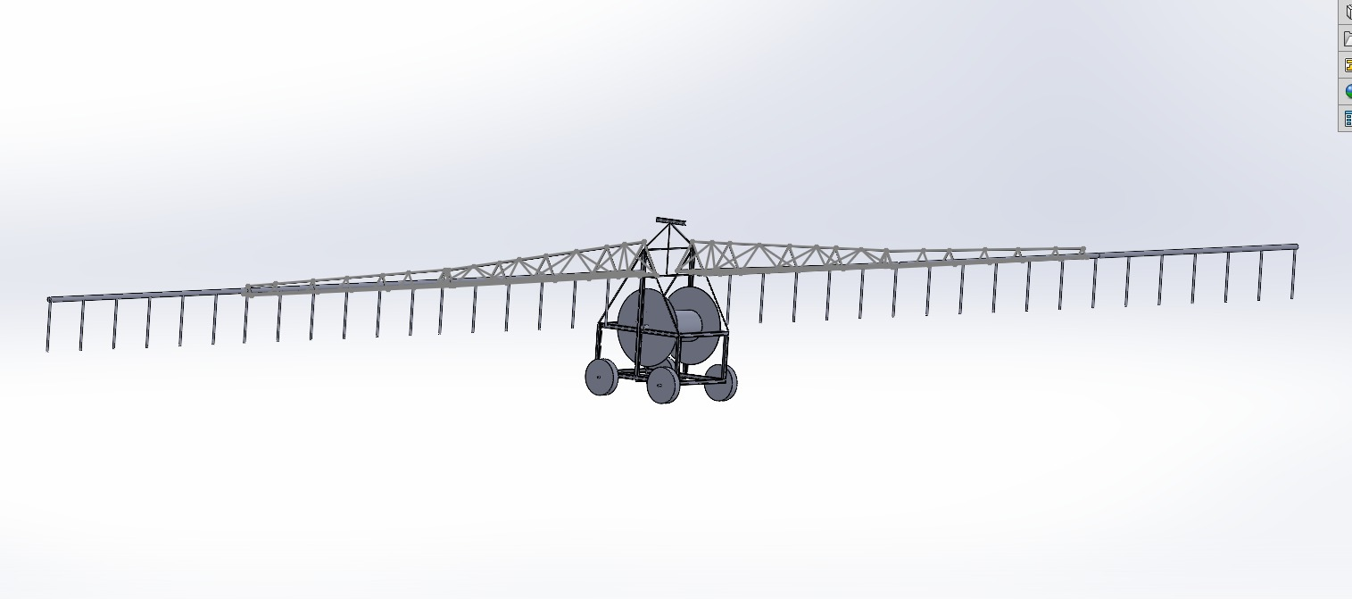
CONCEPT 4

Slide 13
FINAL CONCEPT

Slide 14
RESULTS
Covers 22 potato rows simultaneously.
Total flow rate: 220 mL/s.
Hydraulic power available: 220 W.
Travel speed: 0.056 m/s.
Coverage rate: 0.40 ha/hr.
Irrigates 2 ha in 5 hours and 5 ha in 12.5 hours.
Safe design (FOS > 2).
Production cost: US$522.28.
Suitable for 2–5 ha small-scale commercial farms.

Slide 15
ECONOMIC ANALYSIS
Material cost US$422.28
Labour cost US$100.00
Total Production Cost US$522.28
Selling Price US$650
Break even units 4units

Slide 16
RECOMMENDATIONS
Optimize the hydraulic drive mechanism to improve propulsion efficiency and reduce pressure losses.
Incorporate adjustable speed control to accommodate different irrigation requirements.
Install pressure regulation devices to ensure uniform water distribution across all emitters.
Develop a row-guidance mechanism to improve alignment and irrigation accuracy.
Integrate a filtration system to prevent emitter clogging and reduce maintenance.
Investigate the suitability of the design for other row crops beyond potatoes.
Explore the integration of low-cost sensors for improved irrigation monitoring and control.

